Slide 1
SOFTWARE BUG resolution Assignment: A MACHINE LEARNING INTEGRATION
MIT Capstone Topic Proposal
Presented by:
Joane Marie Llamera
Dr. Khatalyn Mata
Adviser

Slide 2
Agenda
An Integration of Machine Learning on Software Bug Reporting
- Background of the Study
- Statement of the Problem
- Objectives of the Study
- Literature Mapping
- Theoretical Framework
- Methodology

Slide 3

Background of the Study
An Integration of Machine Learning on Software Bug Reporting
According to a survey conducted by the National Institute of Standards and Technology (NIST), the annual cost of software vulnerabilities is estimated to be around $59.5 billion.
- maintenance costs account for at least 50%, and in some cases more than 90%, of total costs associated with a software product
Notes:
In the lifecycle of a software project, bug fixing is an essential aspect of the development and maintenance phases.
A bug is a coding error that can lead to anomalous program behaviour.
According to a survey conducted by the National Institute of Standards and Technology (NIST), the annual cost of software vulnerabilities is estimated to be around $59.5 billion.
According to some software maintenance studies, maintenance costs account for at least 50%, and in some cases more than 90%, of total costs associated with a software product

Slide 4
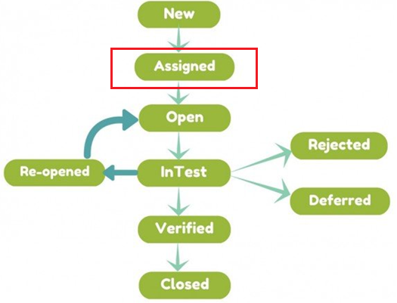


Background of the Study
An Integration of Machine Learning on Software Bug Reporting
Bug Assignment is a manual process
Notes:
Two of the most popular bug tracking softwares are BugZilla and Jira
When software testers find a bug, they will create a bug report to begin the process of fixing it.
Before verifying and modifying a bug, each bug report must be assigned to a relevant developer who could fix it [7]. This process of assignment is called bug triage.
Software bugs must be dealt swiftly in large-scale software projects wherein erroneous bug report assignment to development teams can be quite costly.
In traditional bug repositories, all the bugs are manually triaged by some specialized developers (triagers) [7].
On average, Mozilla received 170 and Eclipse 120 new bug reports on each day from January to July 2000

Slide 5
Statement of the Problem
An Integration of Machine Learning on Software Bug Reporting
Many organizations use issue tracking systems like Mozilla BugZilla and Atlassian JIRA to deal with bugs in a methodical way. While these issue tracking systems have been proven to be effective in managing issues, these systems still require manual identification of the bug assignee which consumes a significant amount of time and effort. This process is also found to be error prone on which bugs are assigned to the wrong developer/team (Bug Tossing) which ultimately delay the bug resolution.
If all of the bug reports need to be manually assigned to the most appropriate developers, the bug triaging tasks would take a lot of time and effort. (Xia et al., 2017)
Notes:
Software bugs are an unavoidable part of the software development process.
While software bugs must be fixed for the product to be of high quality, addressing them in a timely manner comes at a cost.
manually inspecting and assigning bug reports is tedious and time consuming, especially in those software projects that have a large amount of bug reports and developers.

Slide 6
Objectives of the Study
An Integration of Machine Learning on Software Bug Reporting
The main objective of this capstone project is to apply Machine Learning for bug assignment on Software Bug Reporting.
Specifically, this capstone project seeks to achieve the following objectives:
To extract previously fixed bugs and generate keywords by using NLP (Natural Language Processing).
To categorize and train extracted data by development team using Multiclass SVM (Support Vector Machines) algorithm.
To recommend resolving team to incoming bugs based on trained data model.

Slide 7
Review of Related Literature and Studies
An Integration of Machine Learning on Software Bug Reporting
Related Study Title and Author/s | Summary
Developing bug severity prediction models using word2vec (Agrawal & Goyal. 2021) | Used word2vec technique in developing prediction models to assist developers in classifying bug severity levels.
Improving Priority Prediction for Bug Reports with Comment Features (Dao & Yang, 2021) | Proposed a novel prediction scheme to improve the priority prediction performance with comment features
Bug severity prediction using question-and-answer pairs from Stack Overflow (Tan et al., 2020) | Used Naïve Bayesian, k-Nearest Neighbor algorithm (KNN), and Long Short-Term Memory (LSTM) for predicting severity of bug report
Semantic Categorization of Software Bug Repositories for Severity Assignment Automation (Hamdy, 2020) | Hierarchical Dirichlet Process (HDP) topic modeler for identifying bug severity
Text analytics-based severity prediction of software bugs for apache projects (Kaur & Jindal, 2019) | Used ML techniques on predicting severity of bugs
Bug Triaging Based on Tossing Sequence Modeling (Xi et al, 2019) | Focused on the tossing sequence
Automatic Bug Priority Prediction Using DNN Based Regression (Zhang & Challis, 2019) | Use of Deep Neural Network for Priority Prediction
Notes:
This section itemize the list of studies regarding improvements on defect triage process

Slide 8
Review of Related Literature and Studies
An Integration of Machine Learning on Software Bug Reporting
Related Study Title and Author/s | Summary
Genetic Approach based Bug Triage for Sequencing the Instance and Features (Jaiswal et al., 2018) | Multi-Network Anchoring (MNA) technique
Enhanced Feature Selection Algorithm for Effective Bug Triage Software (Gholap & Karlekar, 2018) | Proposed the method of feature selection by using the Kruskal method
Improving Automated Bug Triaging with Specialized Topic Model (Xia et al.,2017) | Used multi-feature topic model (MTM) which extends Latent Dirichlet Allocation (LDA) for bug triaging
Effective bug triage with Prim's algorithm for Feature Selection (Chopade et al., 2017) | Naive Bayes Classifier and Prim's Algorithm for bug triage
Improving Bug Triage with Relevant Search (Peng et al., 2017) | Used relevant search-based method to recommend developers for bug triage
Notes:
This section itemize the list of studies regaridng improvements on defect triage process

Slide 9
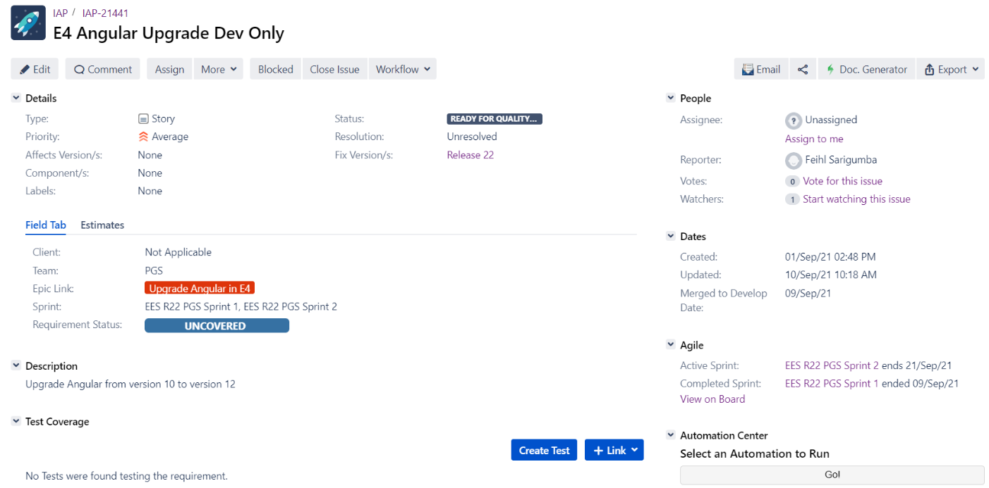
Theoretical Framework
An Integration of Machine Learning on Software Bug Reporting
Sample Bug Report in JIRA
Notes:
In a bug repository, a bug is kept up as a bug report, which records the textual depiction of reproducing the bug and updated as per the status of bug fixing.
Predefined fields, text descriptions, attachments, and dependencies are all included in a bug report for the purposes of problem management and resolution.
Some properties, such as the assignee, the present status, and the eventual resolution, may be regularly updated. The natural language contents of a bug report, including the title of the bug report and a comprehensive description of the bug, are referred to as the text description.
The “Assignee” metadata points out one developer who is responsible for fixing the bug report.
When a new bug report is submitted or reported, the manager (a senior developer or the project leader) selects a developer to address the issue. During the bug-fixing process, developers and reports will engage with one another via comments,
Manually evaluating and allocating problem reports is time-consuming and tiresome, particularly in software projects with a large number of bug reports and developers.

Slide 10
Theoretical Framework
An Integration of Machine Learning on Software Bug Reporting
Classification vs Regression
Both Supervised Learning algorithms
The main difference between Regression and Classification algorithms that Regression algorithms are used to predict the continuous values such as price, salary, age, etc. and Classification algorithms are used to predict/Classify the discrete values such as Male or Female, True or False, Spam or Not Spam, etc.
Notes:
The researcher formulates the bug assignment problem as a classification task.

Slide 11
Theoretical Framework
An Integration of Machine Learning on Software Bug Reporting
Text Classification
Text Classification is an automated process of classification of text into predefined categories.
This can be done with the help of Natural Language Processing and different Classification Algorithms
Notes:
Most previous work can either be classified as ML classification problems or Information Retrieval (IR) problems.
ML-based bug assignment uses supervised learning to classify bug reports to the most relevant developer. IR-based bug assignment on the other hand, considers bug reports as queries and developers as documents of various relevance given the query.

Slide 12

Theoretical Framework
An Integration of Machine Learning on Software Bug Reporting
Natural Language Processing
Tokenization
Tokenization is the process of breaking down a large chunk of text into smaller tokens. Tokens can be words, characters, or sub words in this case. Tokenization can thus be divided into three categories: word, character, and sub word (n-gram characters) tokenization.
Notes:
NLP is a branch of artificial intelligence which is focused on the enabling the computers to understand and interpret the human language.
The first thing you need to do in any NLP project is text preprocessing. Preprocessing input text simply means putting the data into a predictable and analyzable form. It’s a crucial step for building an amazing NLP application.
Tokenization is a key (and mandatory) aspect of working with text data
The most often used tokenization algorithm is word tokenization. It divides a chunk of text into distinct words using a delimiter. Different word-level tokens are created depending on the delimiters. Word tokenization includes pre-trained word embeddings like Word2Vec and GloVe.

Slide 13
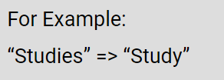
Theoretical Framework
An Integration of Machine Learning on Software Bug Reporting
Natural Language Processing
Lemmatization
Lemmatization is a method responsible for grouping different inflected forms of words into the root form, having the same meaning. The Morphological analysis would require the extraction of the correct lemma of each word. The goal of removing inflectional endings solely and returning the base or dictionary form of a word, also known as the "lemma."

Slide 14

Theoretical Framework
An Integration of Machine Learning on Software Bug Reporting
Natural Language Processing
Stop Words
Stop words are English words that don't add much to a sentence's meaning.
They can be safely ignored without jeopardizing the sentence's meaning.

Slide 15
Theoretical Framework
An Integration of Machine Learning on Software Bug Reporting
Natural Language Processing
Word Vectorization
Method for converting a group of text documents into numerical feature vectors. There are other approaches for converting text data into vectors that the model can comprehend, but the TF-IDF method is by far the most prevalent.
The TF-IDF algorithm is a combination of two algorithms.
• Term Frequency
o TF(t) = (Number of times term t appears in a document) / (Total number of terms in the document)
• Inverse document frequency
o IDF(t) = log_e(Total number of documents / Number of documents with term t in it)
Notes:
Term frequency (TF) is how often a word appears in a document, divided by how many words there are.
Term frequency is how common a word is, inverse document frequency (IDF) is how unique or rare a word is.

Slide 16
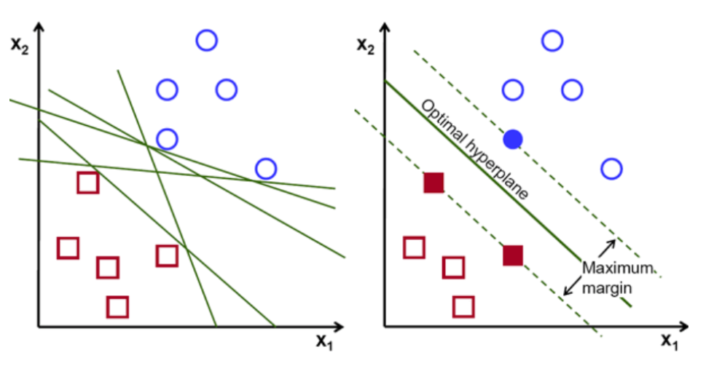

Theoretical Framework
An Integration of Machine Learning on Software Bug Reporting
Support Vector Machines
A supervised machine learning technique that can be used for classification and regression. SVMs are based on the concept of determining the optimum hyperplane for dividing a dataset into two classes.
Linear SVM
Notes:
SVM classification is based on the idea of decision hyperplanes that determine decision boundaries in input space or high dimensional feature space. The linear separator is commonly constructed with maximum distance from the hyperplane to the closest negative and positive samples.
the objective is to find a hyperplane that maximizes the separation of the data points to their potential classes in an -dimensional space. The data points with the minimum distance to the hyperplane (closest points) are called Support Vectors.
The support vectors of the hyperplane are the two dotted lines that run parallel to the hyperplane and cross the nearest points of each of the classes. The distance between the supporting vectors and the hyperplane is now referred to as a margin. And the SVM algorithm's goal is to maximize this margin. The hyperplane with the greatest margin is the best hyperplane.
Linear SVM is used to categorize data that is linearly separable, i.e. a dataset that can be divided into two groups using a single straight line.
To begin, a set of points from each class is plotted and visualized as shown in Figure 3.3. We can efficiently separate these two classes in a 2-d space by simply applying a straight line. However, various lines can be used to classify these classes.
Essentially, choose the hyper-plane that best separates the two groups. This is accomplished by increasing the distance between the closest data point and the hyper-plane. The better the hyperplane and the better the categorization results, the bigger the distance. The hyperplane chosen has the greatest distance from the nearest point from each of those classes, as shown in the diagram in Figure 3.3.

Slide 17
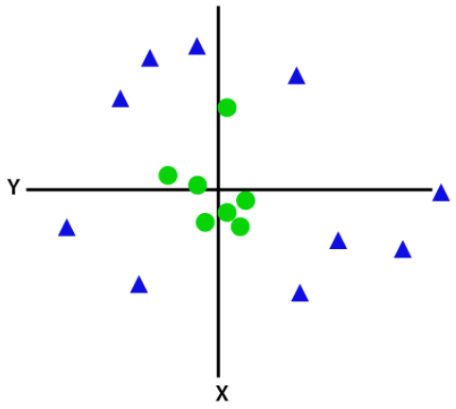
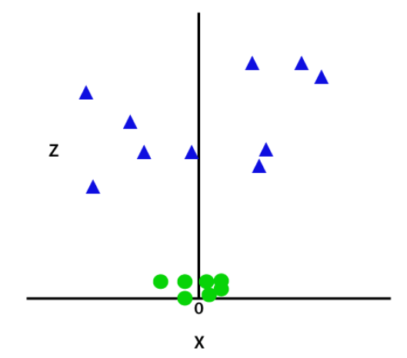
Theoretical Framework
An Integration of Machine Learning on Software Bug Reporting
Support Vector Machines
Non-linear SVM
The SVM kernel function translates a lower-dimensional input space to a higher-dimensional space.
Notes:
It is simple to create a linear hyper-plane between these two classes in the SVM classifier. However, if the data is not linearly separable, the SVM algorithm employs a technique known as the kernel trick., it turns a not separable problem into a separable problem. Complex data transformations are performed based on the labels or outputs that specify them.
The four commonly used families of kernels are:
• Linear kernel
• Polynomial kernel with degree d
• Radial basis function (RBF) kernel (σ is a positive
parameter for controlling the radius)
• Sigmoid kernel (δ is a positive parameter)

Slide 18
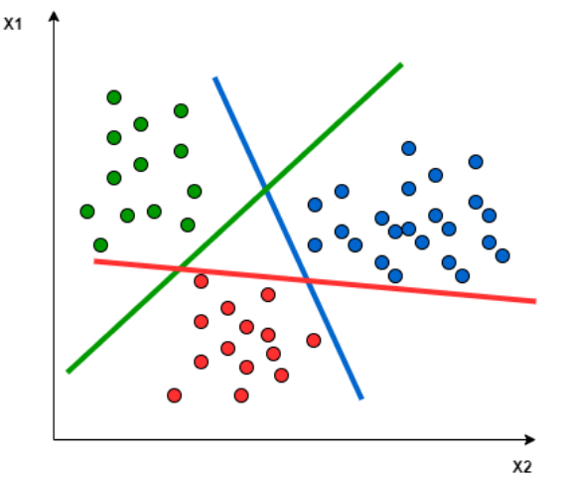
Theoretical Framework
An Integration of Machine Learning on Software Bug Reporting
Multiclass SVM
In case of Multi-class classification problems, the issue becomes more complex because the outputs could be more than one class and must be divided into M mutually exclusive classes.
Multi-class SVMs (MCSVM) are usually implemented by combining several binary SVMs

Slide 19
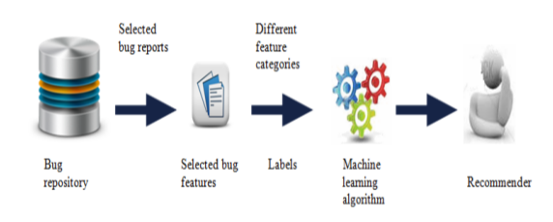
Methodology
An Integration of Machine Learning on Software Bug Reporting
Proposed Bug Assignment Using ML

Slide 20
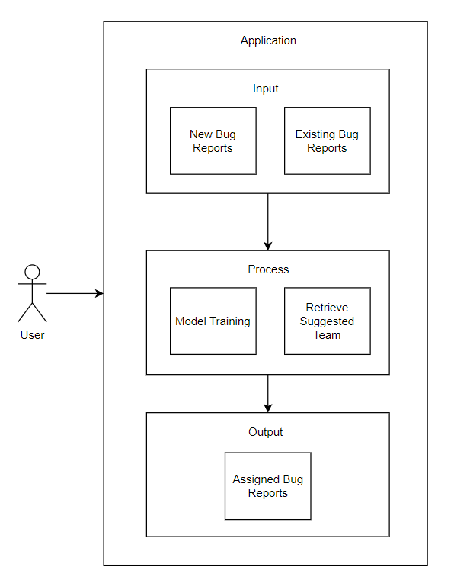
Methodology
An Integration of Machine Learning on Software Bug Reporting
Conceptual Framework
Notes:
Previously resolved bug reports are used to train the data model. Labels extracted from the bug Title and Description through data pre-processing and are used to train the data model.
One of the system users are the bug reporter who will manually input the bug report attributes such as Title, Description, Priority, Severity, Reported By, Reported Date. With the algorithm therein, when a bug reporter enters the bug details, the application will be able to retrieve the recommended team to resolve the bug.

Slide 21
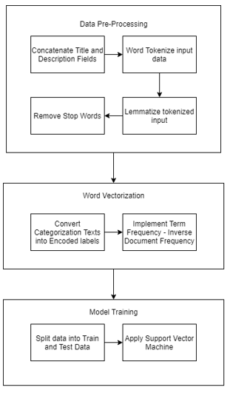
Methodology
An Integration of Machine Learning on Software Bug Reporting
High Level Data Processing
Notes:
Bug report summaries are unstructured data that must be pre-processed before being converted to structured data. As a result, the proponent will use the usual text pre-processing method to convert the text data into a meaningful representation:
Concatenation of Title and Description attributes
Tokenization - split the summary of each bug report into tokens (terms)
Lemmatization - combining a word's several inflected forms into a single item for analysis
Removal of Stop Words
The next step is Vector space representation where each bug report is represented as a vector and each word in the bug report represents a label. We use the Term Frequency - Inverse Document Frequency (TF-IDF) of the word to get the value of each word feature.
SVM a supervised classification algorithm that finds a decision surface that maximally separates the classes of interest, will be used in this study.

Slide 22
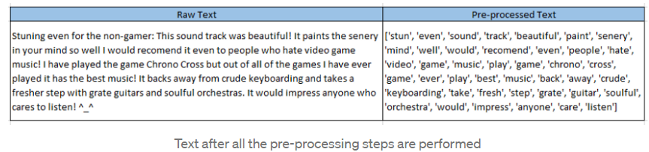
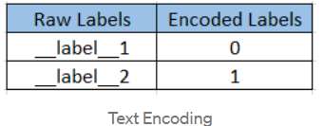
Methodology
An Integration of Machine Learning on Software Bug Reporting
Data Pre-Processing
Notes:
The Corpus will be split into two data sets, Training and Test. The training data set will be used to fit the model and the predictions will be performed on the test data set
Label encode the target variable — This is done to transform Categorical data of string type in the data set into numerical values which the model can understand.

Slide 23
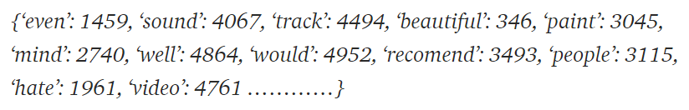
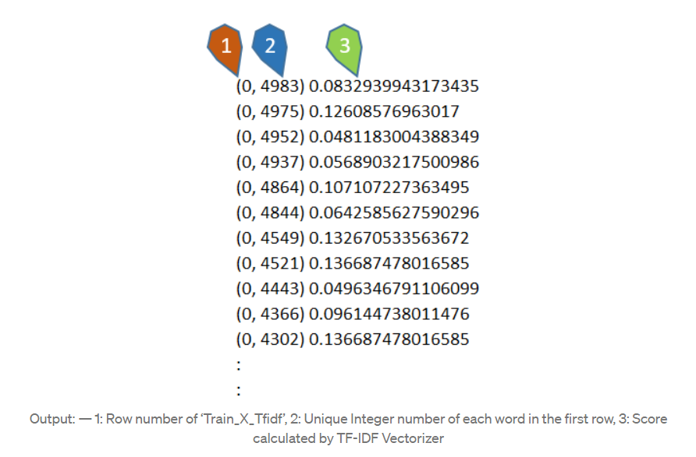
Methodology
An Integration of Machine Learning on Software Bug Reporting
Word Vectorization
Notes:
Now our data sets are ready to be fed into different classification Algorithms.

Slide 24
Methodology
An Integration of Machine Learning on Software Bug Reporting
Bug Reporting Flow Chart

Slide 25
An Integration of Machine Learning on Software Bug Reporting
THANK YOU
Notes:
High Level Data Processing

